Slide 1
26/01/24

Slide 2
Rules
This is NOT a club for messing about/!
If you join this club it is to learn and get ahead of others!
If you don’t listen/participate I won’t help you!
If you fall behind too much I will give up on you.
I plan on making it hard work!!!
I also won’t force anyone to leave this club, but if it doesn’t interest you or some other reason, feel free to leave… I will however take away your lunchpass.
I have a couple of bad habits (WATCH OUT FOR THEM):
I sometimes lose my train of thought (bare with me)
My Desktop is messy (and I’m not well organised)
I will ramble on (drone/speak)
I will sometimes be unclear (ask if you don’t understand)

Slide 3
Task for Today
Code Inputs & Types
Code Outputs & Formatting

Slide 4
Data Types in Python
Text types: str
Numeric types: int, float, complex
Sequence types: list, tuple, range
Mapping types: dict
Set types: set, frozenset
Boolean types: bool
Binary types: bytes, bytearray, memoryview
None type: Nonetype
We won’t be using all of them so don’t worry :D

Slide 5
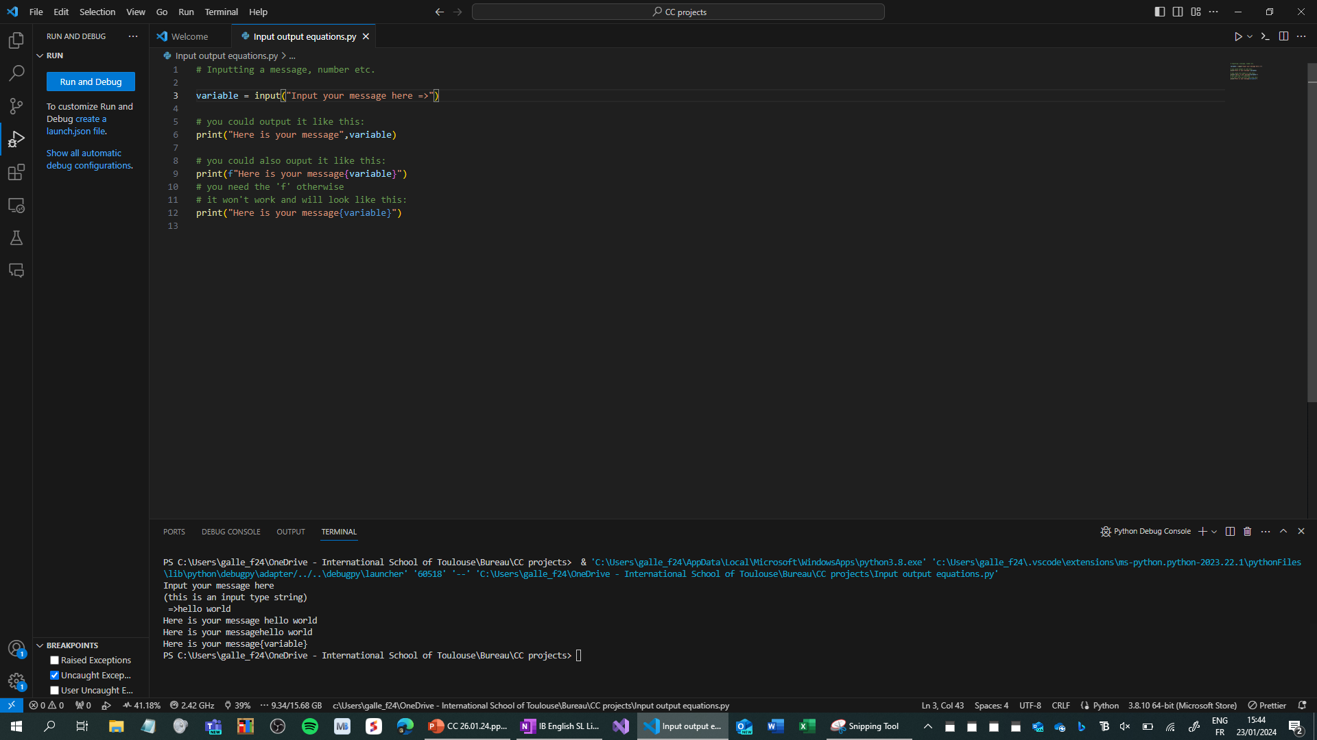
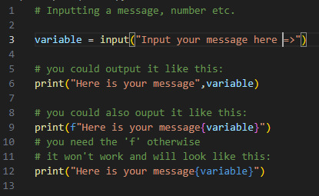

Slide 6
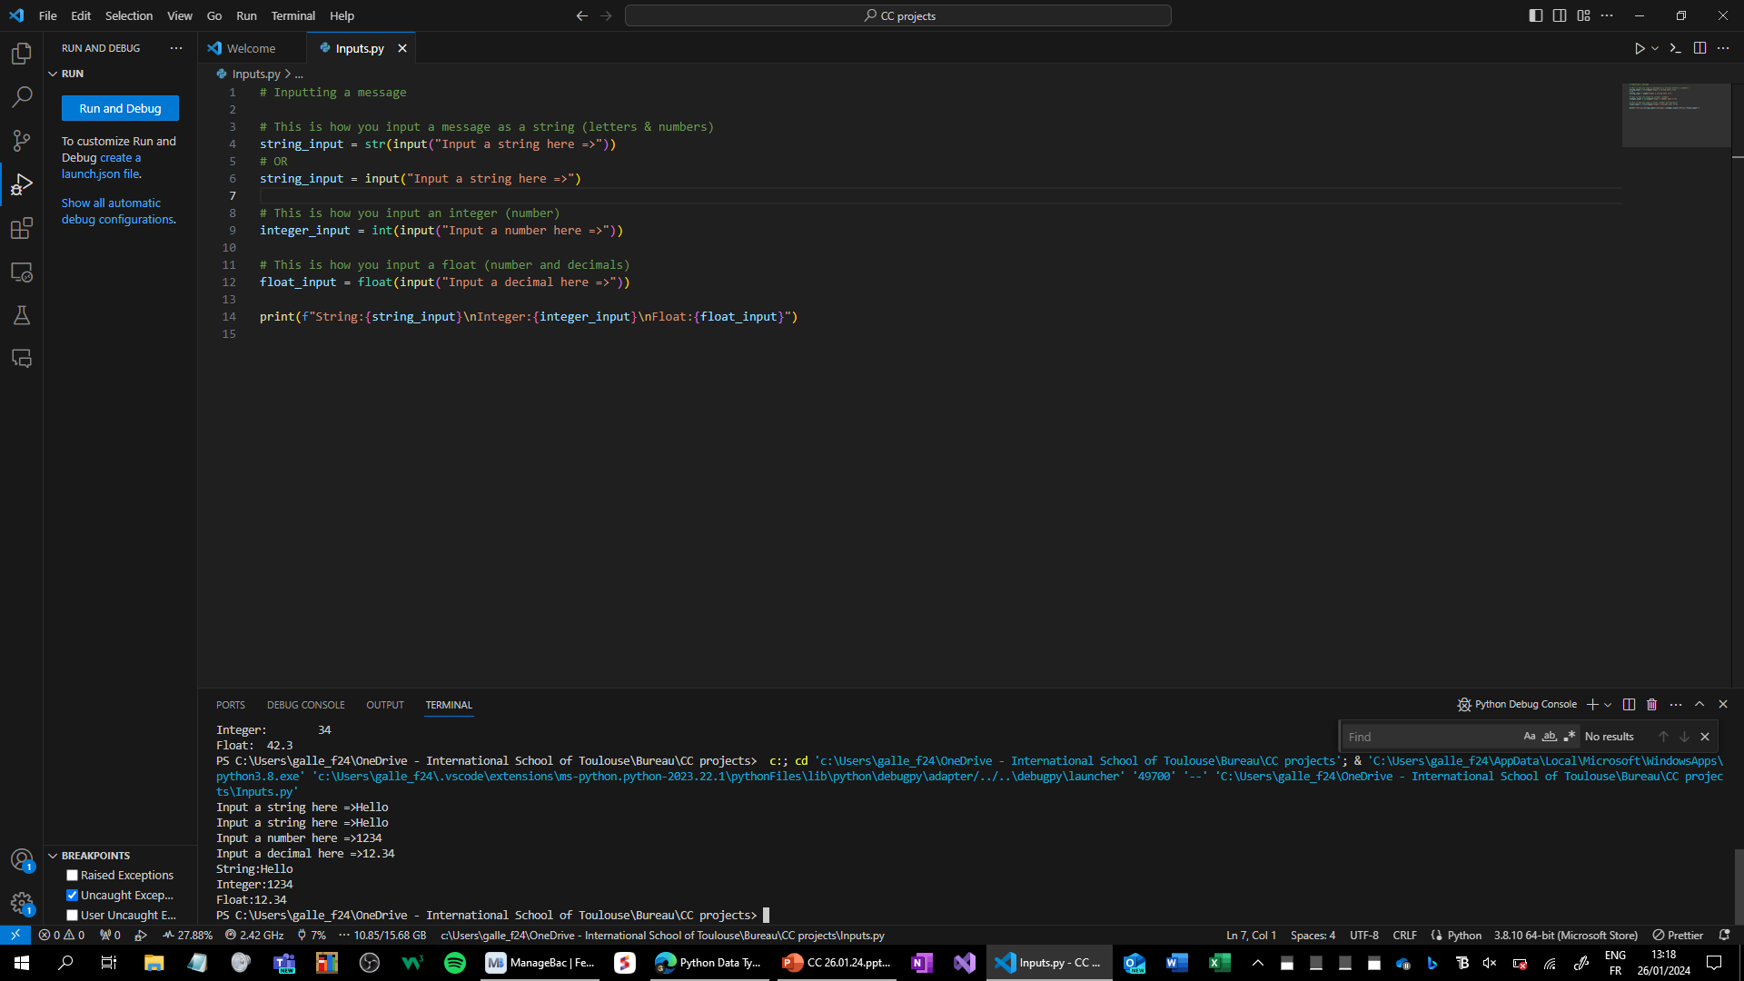

Slide 7
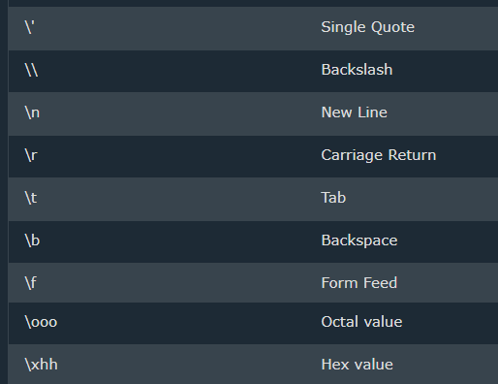
Formatting (Escape characters)
These are known as escape characters.

